Slide 1
Work, Exchange, and Technology
Sam, Ashwin, David, Arya, Caitlin, Rachel

Slide 2
TRENDS
A global, digital economy emerged from the twentieth century out of executive attempts to give spending power to the citizens
Presidential reshape of the economy
Transition to a digital, service-based economy
Recessions caused by laissez-faire economics

Slide 3
Presidential Reshape of the Economy

Slide 4
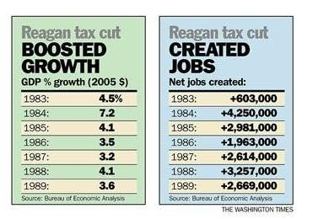
Reagan’s Tax Cut 1982
Plan to beat inflation
Relief suffering to lower and middle class
Provided more jobs
Economic Recovery Tax Act (ERTA)
25% reduced personal income tax rates
Businesses aided by accelerated capital recovery
Special tax treatment of troubled thrift institutions
Increased amount of retained earnings not subject to taxation
Relaxed rules of Subchapter S Corporations
Encouragement of merger activity

Slide 5
National debt triples (1981-1989)
Reagan’s supply-side policies cut taxes and domestic spending
Drop in energy prices
High interest rates
US in great debt to foreign nations ($340 billion)
Billions of dollars into defense spending
$914 billion in 1980 to $2.7 trillion in 1989
Fiscal crisis became structural problem

Slide 6
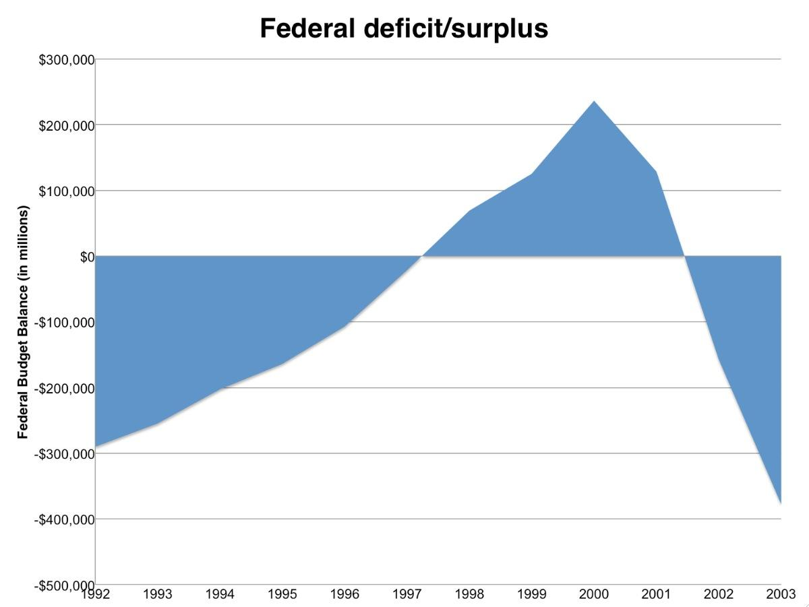
Debt Reduction under President Clinton
Largest period of sustained economic growth in history
Reduced deficit by $360 billion
Added 22 million jobs
Achieved through spending cuts, investments in the private sector, and opened foreign markets

Slide 7
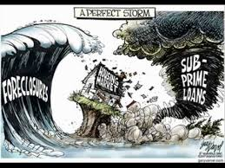
Bank Bailout (2008)
What caused the Subprime mortgage crisis
Triggered by a decline in home prices after the collapse of the housing bubble
Home buyers: Took advantage of easy credit to bid up the prices of homes
Mortgage Brokers: Offered less-credit-worthy home buyers, adjustable rate loans with low initial payments, but high interest rates
Wall Street firms: Who paid little attention to the loans they bundled into mortgage backed securities
Outcome of the Bank Bailout
Bush passes Emergency Economic Stabilization Act which created the $700 billion Troubled Assets Relief Program
The treasury intended to buy mortgage backed securities at a discount from banks which would cause banks to start lending again

Slide 8
Transition to a Digital, Service-Based Economy

Slide 9
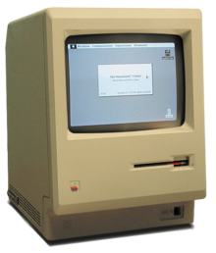
Apple Personal Computer Introduced (1983)
Macintosh-first personal computer to be sold without a programming language at all
Combination of Macintosh, LaserWriter, PageMaker were responsible for the creation of the desktop publishing market
Company lost its monopoly in the market and ability to overprice products when similar products sold for significantly lower prices
Later outsourced manufacturing jobs

Slide 10
The Rise of the Internet
Early versions have been around since the late sixties
Companies started using it in the eighties
Gained popularity in the Mid-nineties due to new features
Companies began to take advantage of the resources it offered

Slide 11
North American Free Trade Agreement (NAFTA)
Agreement between USA, Canada, and Mexico that opened trade barriers and encouraged foreign investment
Set a precedent for other free trade agreements (FTAs) with other nations
PROS | CONS
Significantly decreased service costs and ultimately put more money in the pocket of the average American | Accelerated the decline of American manufacturing (AFL-CIO estimates 700,000 jobs lost)

Slide 12
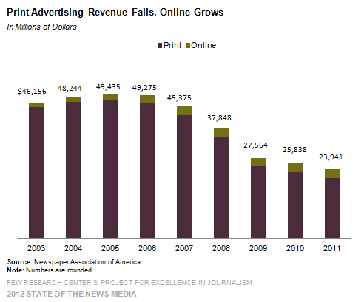
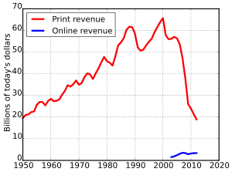
Crisis in the Newspaper Industry
Introduction of the internet
2005 had record high sales since the beginning of the internet
Made things appear fine
Technology
Loss of print readers
Not many digital readers
Massive loss of readers
Loss of revenue

Slide 13
Recessions Caused by Laissez-Faire Economics

Slide 14
Recession of 1981-1982
Worst economic downturn since Great Depression
Triggered by strict monetary policy to fight inflation
Paul Volcker targeted money supply over interest rates
Credit-control program (1980) gave way to recession
Volcker told to loosen monetary control--denied request
Target price stability to stop inflation
11% unemployment
Particularly affected manufacturing, construction, and auto industries
Good producers--30% employment, 90% unemployment
75% job loss of good-producers in manufacturing
Construction and auto industries suffered 22%-24% job loss
Economic growth followed due to ERTA

Slide 15
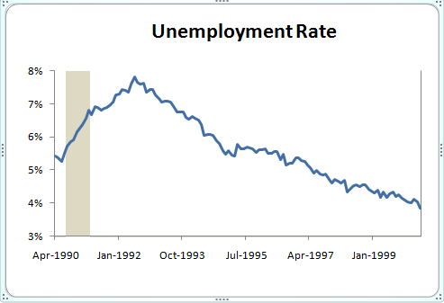
Recession of 1990-1991
Had roots in crash of 1987
Large national debt created problems
Oil prices went up globally due to conflicts in the middle east
This was a factor in George H. W. Bush’s defeat in the election of 1992

Slide 16
Great Recession (2007-2010)
Housing bubble
Cutbacks in consumer spending
Job loss
Slow recovery

Slide 17
Unemployment Hits 10%
Highest unemployment in 26 years
Housing boom created millions of jobs in the mortgage, real estate, and construction industries
Mortgage crisis led to many job losses in those industries
Economy shed an average of 645,000 jobs a month

Slide 18
Financial Industry and GDP
After the mortgage crisis the financial industry recovered and represented 7.2% of the nation's GDP
Financial sector employed 6 million people in 2014
Led to substantial economic activity and direct/indirect job creation
Helps facilitate and finance export of U.S. manufactured goods

Slide 19
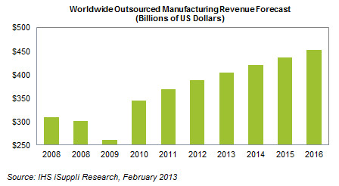
Where do you think we’ll be tomorrow?
+ | -
Advancements in technology | Increasing national debt, increasing decline in US manufacturing, increasing dependence on foreign economies

